Slide 1
Course Scheduling a time for a new system
Ryan Huffman
December 4, 2013

Slide 2
the problem Dissatisfactory Course Availability
Elements of the Problem:
Rigorous Academic Requirements
Competitive Environment
Limited Courses
Paying Students
Breach of Duty
Difficult Force-Add System
Faulty Course Registration System

Slide 3
Evidence
Interviews:
Various Miami Students
Various Backgrounds
Personal Experiences
Expressed: Dissatisfaction
Increased Stress
Peer Reviewed Journals:
The Effect of Late Registration for College Classes—Safer, Alan M.
The Impact of Registration Timing on Student Performance—Hale, Jacqueline M. ; Bray, Nathaniel J.

Slide 4
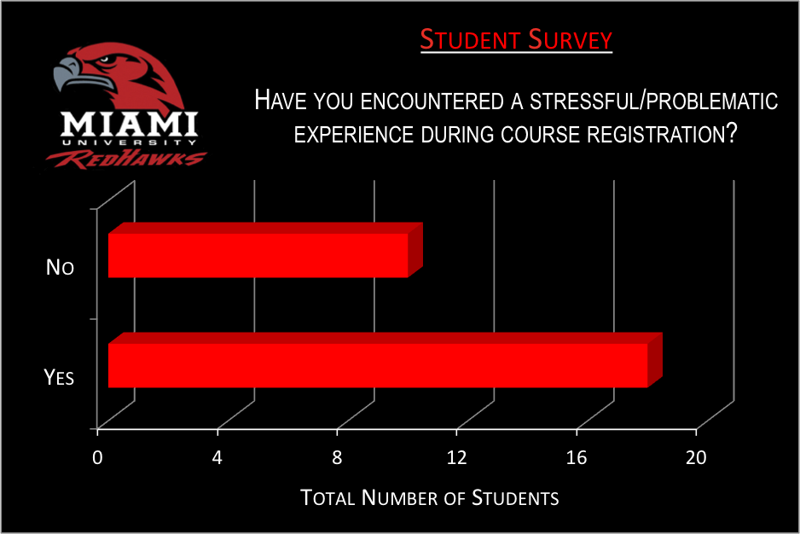
Taking the Problem Further Evidence Cont...
Survey Total: 28 Students
Chosen at Random
Obvious Problem
Comments Provided Much Info
Mentioned Most:
-Force-Add System
-Not Enough Sections
-Priority Scheduling
Priority Scheduling Unfair for the Rest of the Student Body
By: Amy Biolchini

Slide 5
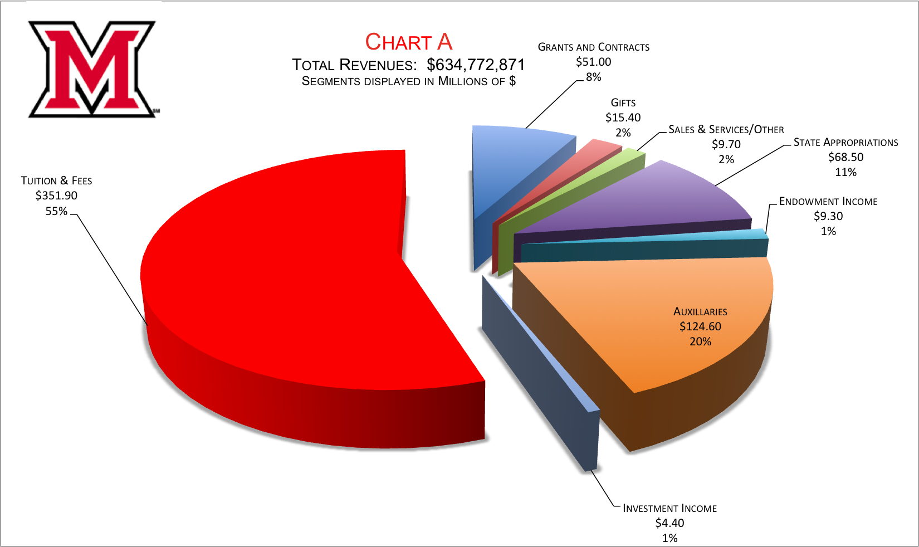
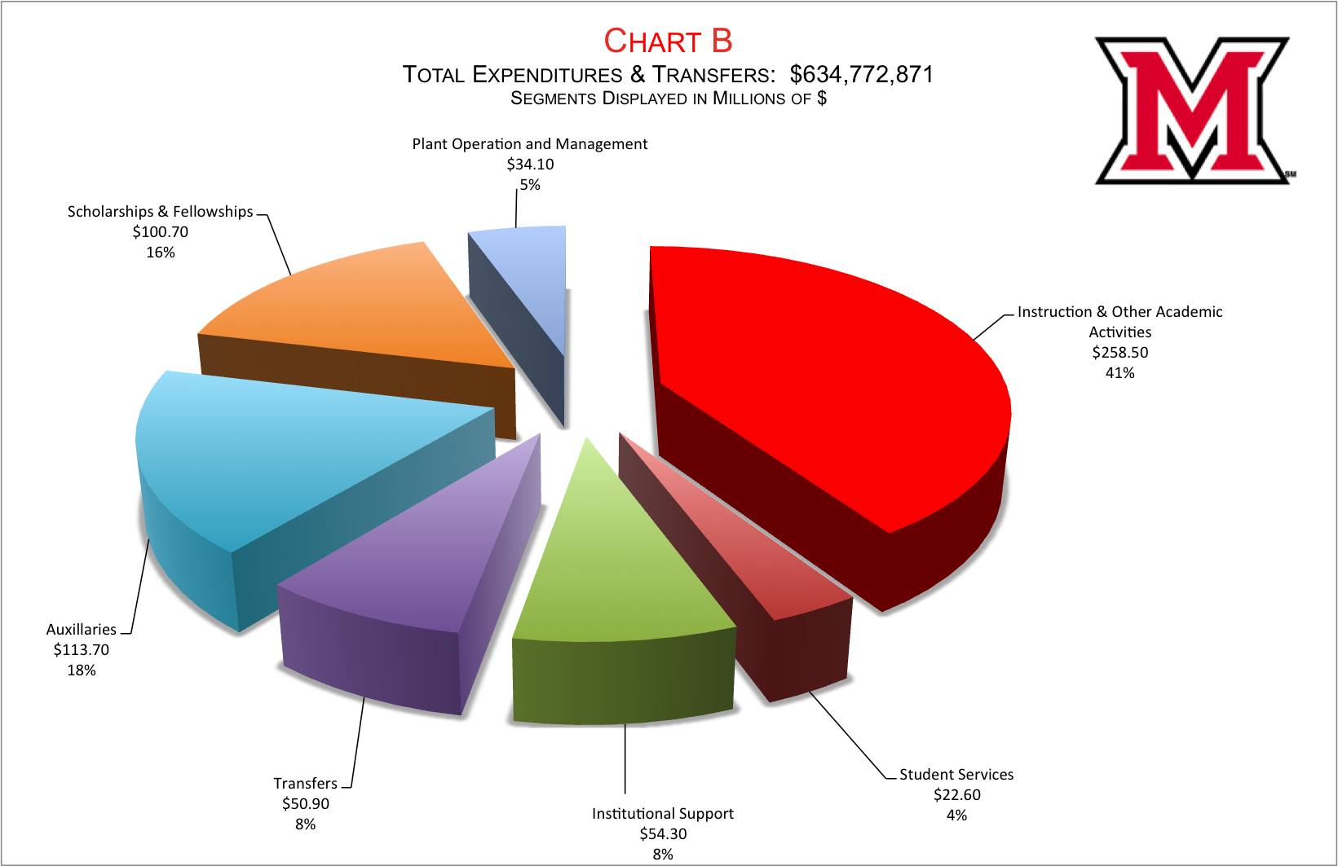
Does the University Care?
University 2011-12 Revenue →
55% from Tuition & Fees
Over Half
University 2011-12 Expenditures
Only 41% Spent on Academics
Miami University Mission Statement:
“…deeply committed to student success…”

Slide 6
Recap
Obvious problem w/ Course Scheduling
Students dissatisfied—Priority Scheduling Hierarchy
Registration Process adds stress to students’ lives
Students are more than willing to voice their opinions
Not enough money allocated to Academics
Need for Change

Slide 7
A Possible Solution
Smarter Money Allocation
Auction Method for Course Registration
An Auction Method for Course Registration-- Graves, Robert L., Schrage, Linus, Sankaran, Jayaram
More Flexible Registration System
A Combination of…

Slide 8
Conclusion & Call-For-Action
Flaw in the system
Causing immense frustration for students
Seen as result for declining grades
In order to resolve this issue
More money allocated towards academics
System set up around preferences/needs of students

