Slide 1
Proposals
What they are. What they do. And how they look.

Slide 2
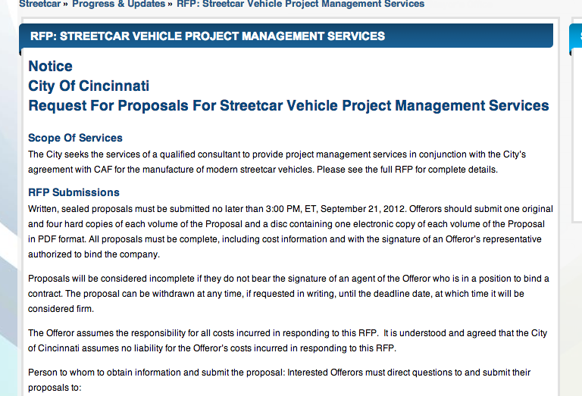
What is a proposal?
A fundamentally persuasive document that requests support (money, materials, resources, permission, etc.) of some kind
2 kinds: solicited or unsolicited

Slide 3
What is the goal of a proposal?
To get permission—and the resources--to carry out the work you propose!

Slide 4
How can you make a proposal persuasive?
Show there is a significant problem or need (and that you understand it)
Provide a method for addressing the problem or need
Indicate that you have the ability to manage the project successfully
Show that you are qualified to do the work
Highlight the major benefits of the proposed action
Justify the use and final cost

Slide 5
What do proposals look like?
They vary—some are highly formal, while others are quite informal. Most are somewhere in the middle.
General Organization:
Heading: Memo format (to, from, date, re)
Overview (often called an Executive Summary)
Background/History
Problem statement and analysis
Plan (usually the longest section)
Supplies, Materials, and Equipment
Personnel
Expected Results and Benefits
Budget

