Slide 1
Miami University Parking Proposal
Genevieve Palmer

Slide 2
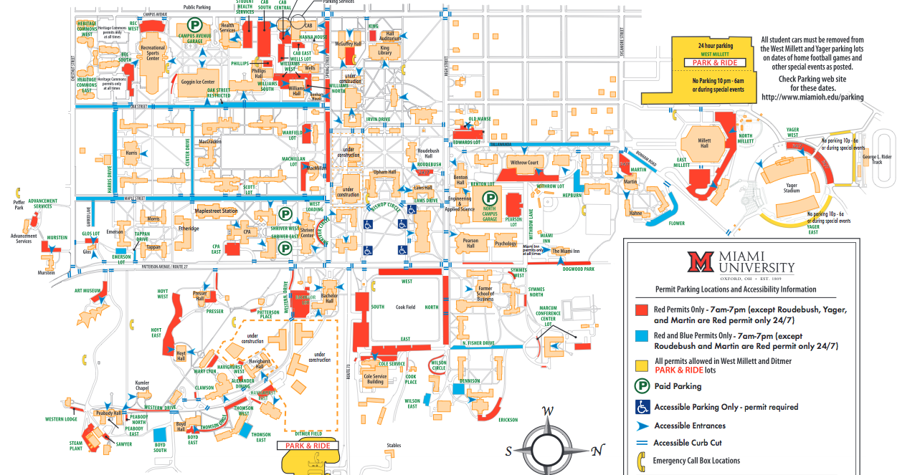

Slide 3
Problem
Third and fourth year undergraduate students who live off campus only have one convenient option of transportation to class-walking.
During bad weather when they need to drive parking on campus is nearly impossible.
Expensive tickets

Slide 4
Support
“Parking services are pretty much the most awful people on the planet.” College Prowler
“Parking is a nightmare”
Overall Grade is a C

Slide 5
Support Cont.....
Testimonial 1: Caroline Hill, Junior who lives by Kroger
Testimonial 2: Rob Vitolo, Junior who lives by La Piniata
Tickets at Meters are $10, while tickets in red spots are $65
Parking Boots are $200, and can be issued after three unpaid tickets.

Slide 6
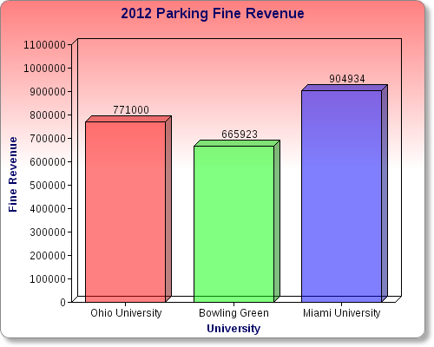
Data

Slide 7
Data
Short-term this money is financially beneficial for Miami.
Long-term the many rules and regulations aimed at ticketing students causes animosity.
Animosity causes future alumni to donate less money or nothing at all.

Slide 8
Long-Term Solution
Miami students would benefit from a new underground parking garage in place of Shriver.
It would reduce the cluttered look of cars parked on the street, also making Miami look more eco-friendly.
It would provide more parking spots for all undergraduates.
It would generate revenue for Miami Parking and Transportation, while reducing parking fines for students.

Slide 9
Short-Term Solutions
Parking meters around campus should allow students to pay for more than an hour.
Miami parking app that informs how many tickets you have and gives a warning if one ticket away from a $200 parking boot.
Enable meters to accept student ID Mulaa through Park Mobile App payment. Then Mycard could send 5 min. left text alerts from the meters.
After implementing above solutions, increase red spot fines to $100. This discourages students from parking illegally and also makes revenue from tickets.

Slide 10
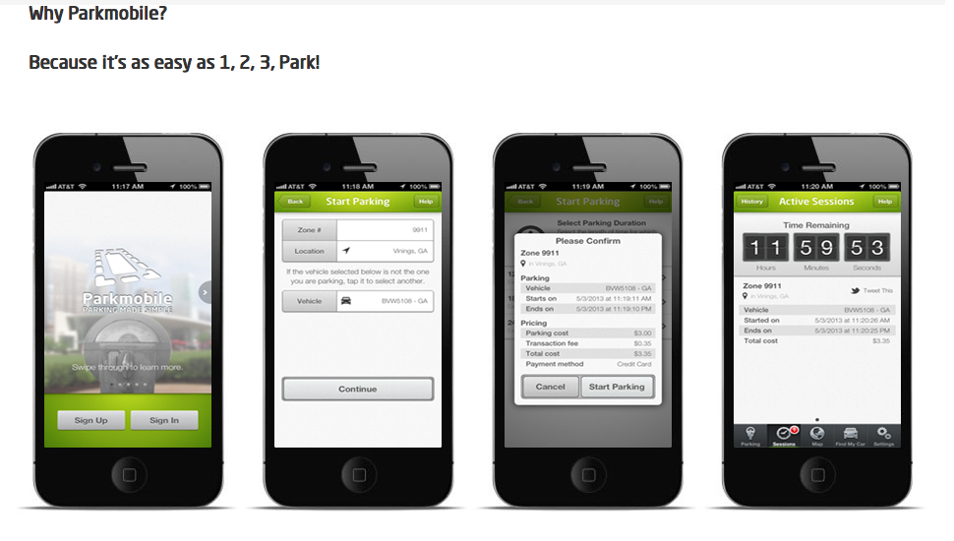
Park Mobile App

Slide 11
Budget
Expenditure | Estimated Cost
Miami Parking App. | $4,000
Park Mobile App. | No Cost to Register; The City of Oxford has to approve it
Two-Story Underground Parking Garage | $6,918,200
Total | $6,922,200

Slide 12
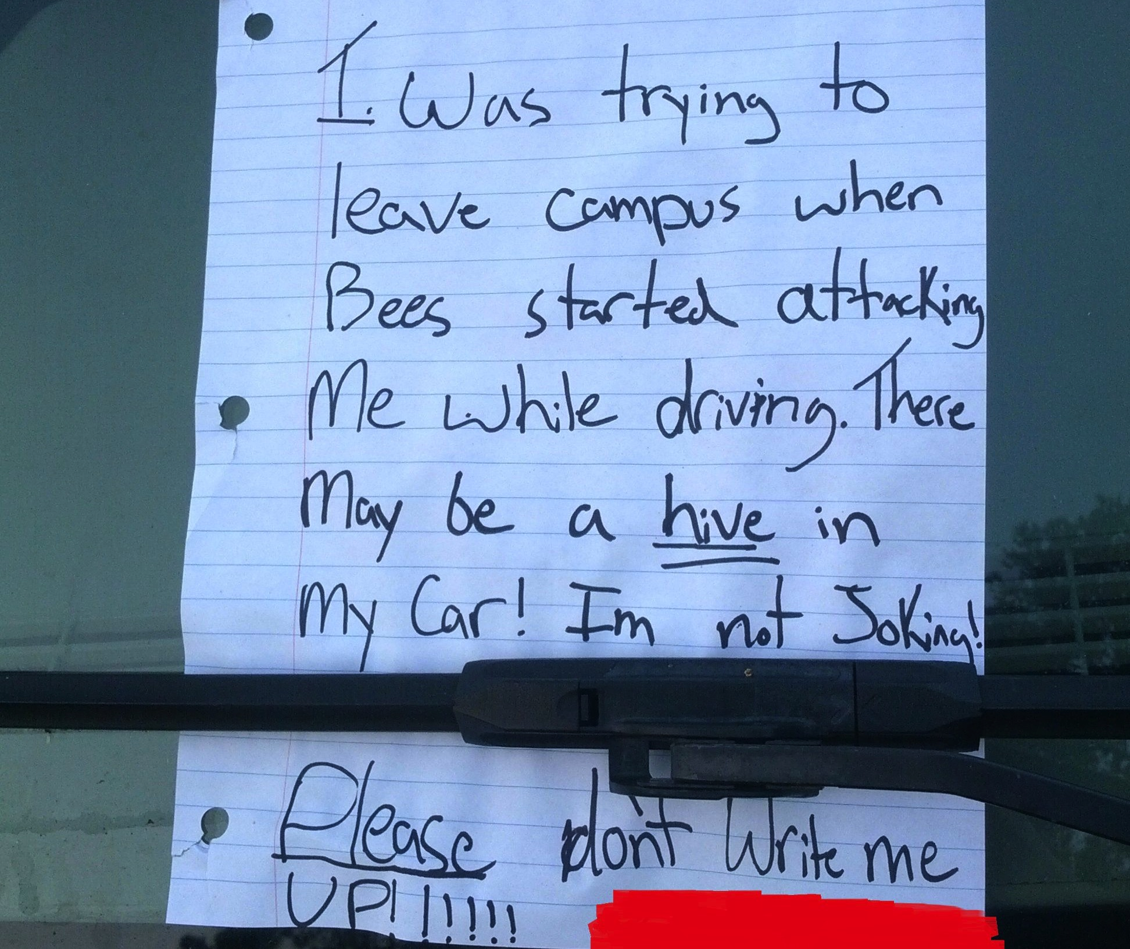
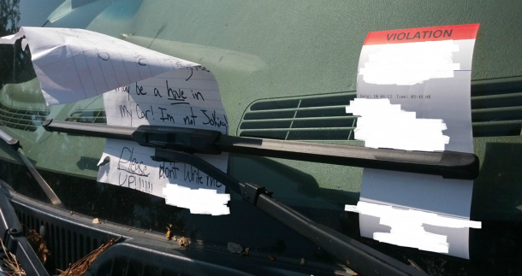
Thank You

