Slide 1
Miami Parking Services
Driving Students crazy Perry Quayle

Slide 2
Overview
Problems
Student Concerns
Proposed Solutions
Budget

Slide 3
Problems
Overly-eager ticketing officials
Multiple colored passes for students
Limited availability of parking lots/spaces

Slide 4
Ticketing Problems
Student vehicles ticketed on move-in weekends
Meters in many lots make student passes irrelevant
Testimonial of visitor: “You don’t even want to know what I had to go through to get this [parking pass].”

Slide 5
Color-Coded Permits
RED PASS
Faculty
Permit
GREEN PASS
Graduate
Assistants
YELLOW PASS
Off-Campus
Students
BLUE PASS
General
Student
Permit
CONFUSING AND RESTRICTING

Slide 6
Limited Space
Campus parking lots with meters
Why even bother having a permit then?
Fewer parking spaces
Loss of over 200 parking spaces from recent construction
No plans to create new parking or make up for these lost spaces.

Slide 7
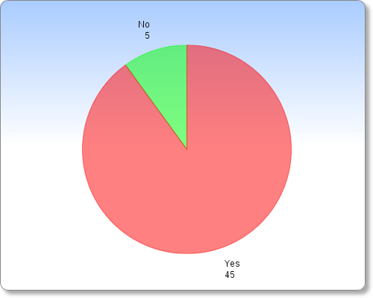
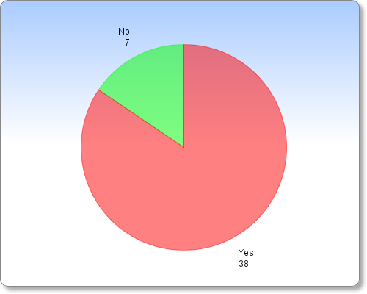
Student Concerns
Do you believe that campus parking services needs reformed?
If it were easier to find a parking spot, would you be more willing to drive to class?

Slide 8
Proposed Solutions
Short-Term Solutions
Somewhat more lenient polices from ticketing officers.
Metered lots that also accept student parking permits.
Long-Term Solutions
Switch from multiple colors to student vs. faculty permits.
Construction of new parking facility.

Slide 9
Budget
New permits = $0
Same number, but single design (might actually save money)
Parking garage construction
$8, 721, 200

Slide 10
Questions?

Slide 11
Sources
http://www.miamistudent.net/news/miami-changes-on-campus-parking-policy-1.2886449#.Up7NU8RDv1l
http://www.reedconstructiondata.com/rsmeans/models/garage/

