Slide 1
Designing Presentations
Making the Best out of PowerPoint

Slide 2
Overview--quick tips
Keep your audience in mind
Don’t put too much on the screen—especially large chunks of text with no breaks
Use colors sparingly; use colors as accents
Be strategic with animation; it should serve a purpose
Be creative—use textboxes and shapes to create easy-to-read and clean design
Include only relevant images; in most cases, avoid clipart
Don’t forget about CRAP!

Slide 3
1. Audience & Rhetoric
What conventions does your audience expect?
  A clean PowerPoint with bullets or something more creative?
  http://randomfoo.net/oscon/2002/lessig/free.html
Does the content of your presentation match the visual display?

Slide 4
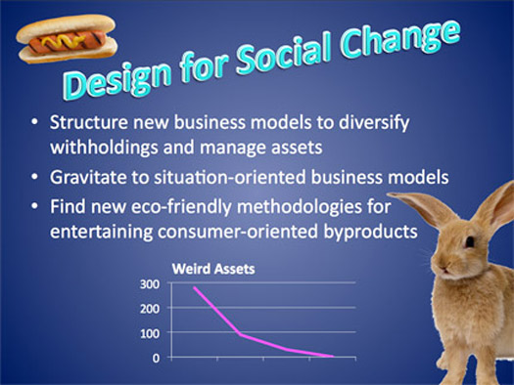

Slide 5
2. Don’t put too much on the screen
Don’t write your slides as if they were full paragraphs. Your audience will get bored and it’s not pleasing to the eye to see so much text on the screen. Your audience wants the main points—not every point! If you find your bullets exceeding two lines, you might want to rethink your strategy! What I have just done is bad. Don’t be a paragraph dumper.
What are some strategies to avoid the above problem?
• Make new slides
• Represent information visually
• Include textual cues
• Include white space

Slide 6
3. Use colors sparingly
Use colors for accent
Keep a consistent color scheme throughout the presentation

Slide 7
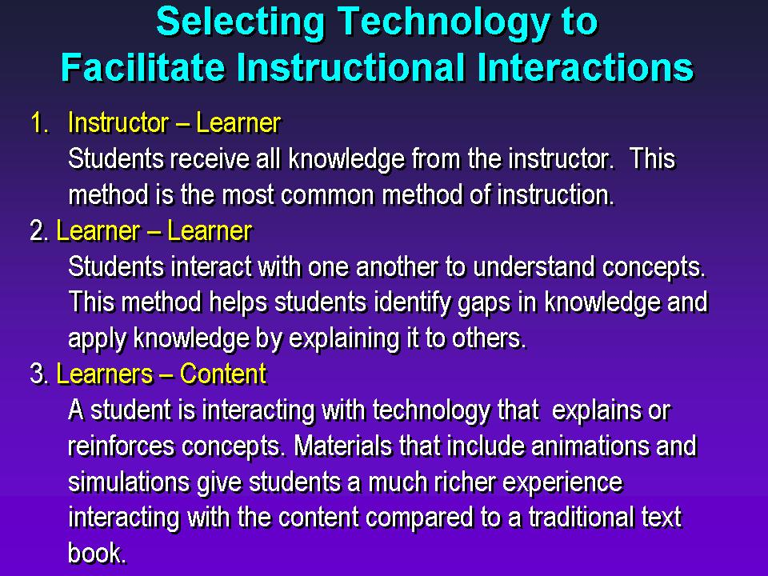

Slide 8
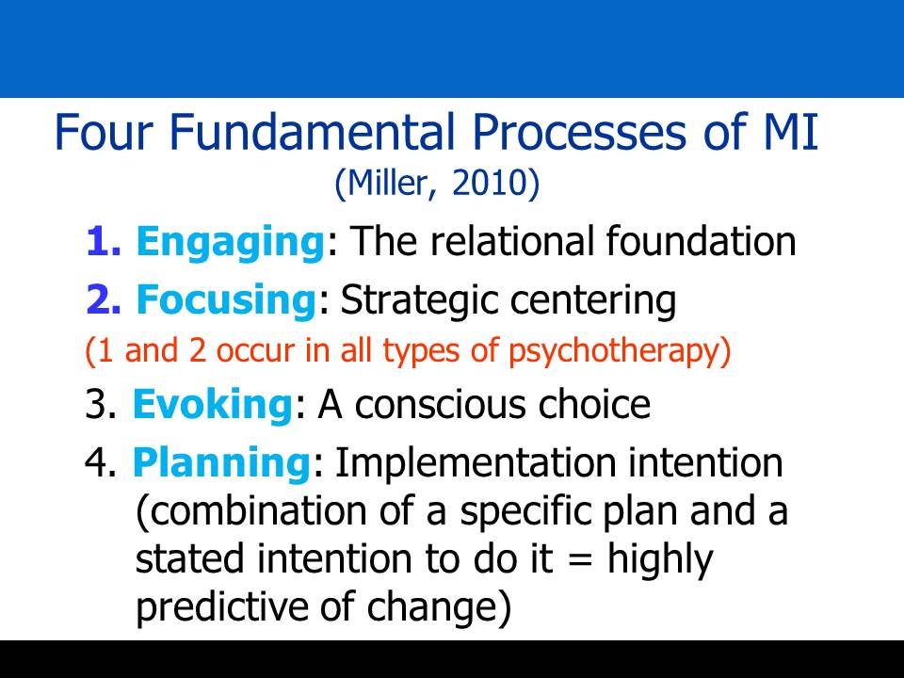

Slide 9
4. Be strategic with animation
Don’t use something in PowerPoint or any presentation software just because you can
Use Animation To:
Create Anticipation
Show a Sequence

Slide 10
5. Be creative
“
This is a really good quote.
No really. It’s good. Keep reading because it’s really interesting.
”

Slide 11
What sort
of effect do
you want to have?
Could this work?

Slide 12




6. Use visuals with care

Slide 13

Miami Professionals
Point 1…. Yep, yep.
Point 2 … more, more
Point 3 … good point.

Slide 14


Slide 15
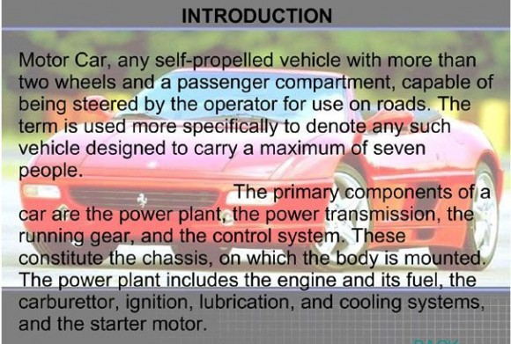

Slide 16
7. Remember CRAP
Contrast
Repetition
Alignment
Proximity

Slide 17
Repetition
Let’s say I want to highlight important words with color—make sure to do this throughout your presentation
It’s wise to not change font style; it’s also wise to avoid making drastic changes to font size

Slide 18
Alignment
Think about alignment with text and visuals/graphs/textboxes

Slide 19
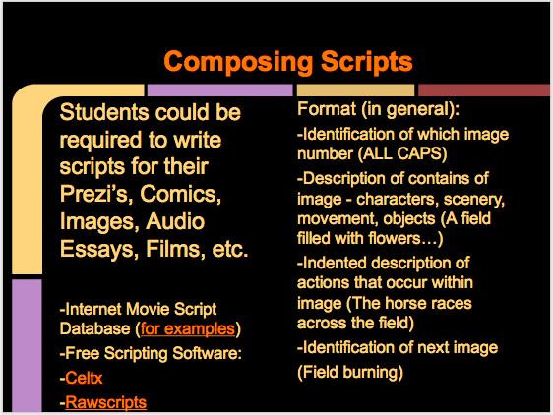
Proximity

Slide 20
To recap:
Keep your audience in mind
Don’t put too much on the screen—especially large chunks of text with no breaks
Use colors sparingly; use colors as accents
Be strategic with animation; it should serve a purpose
Be creative—use textboxes and shapes to create easy-to-read and clean design
Include only relevant images; in most cases, avoid clipart
Don’t forget about CRAP!

