Slide 1
Student employee parking
Alexandra decraene

Slide 2
contents
Introduction
Statement of Need
Evidence
Solution
Summary

Slide 3
introduction
Problem: Parking Options for Student Employees
Notes:
-Parking Options are extremely limited for student employees. The current solutions are also extremely ineffective. Either students can pay out of pocket for a student pass, or pay in meter spots. Neither of these options seem fair to students who are benefiting the university and also trying to earn money.

Slide 4
testimonials
“I work on campus at Williams Hall. There is a parking lot for faculty there, but none for students. There are meters, but they often fill up and I have to go and pay the meter every hour. I have to drive to other locations often, so I have to pay at each location or worry about parking illegally.”
-Jessica Thorne
“This semester alone, I racked up over $75 in parking tickets. Though sometimes it is my own fault, I work as a delivery driver and sometimes don’t have a choice in where I park.”
-Michele Turner
Notes:
These two testimonials come from student employees on campus. They explain some of the problems students have faced with parking services in the past.

Slide 5
Need
“During the past year, more than 5,300 students were employed in various capacities by nearly 150 academic, administrative, and support service departments.”
-Miami University Student Employee handbook
Minimum Wage $7.85
-Ohio Department of Human Resources
Average Hours Worked: 10-15/week
-Miami University Student Employee handbook
Notes:
These facts show a portrait of the average student employee.

Slide 6
Parking passes
Semester Annual
Student areas (blue) $115 $220
Holding lots (yellow) $60 $110
Overnight garage access $420 $840
“Changes to parking permits this year include the elimination of purple (off campus) parking permits and daily parking garage access cards. Students living off campus are now eligible to purchase holding lot (yellow) parking permits, giving them 24-hour access to the West Millett and Ditmer parking lots. Students may still pay hourly rates to park in the North Campus or Campus Avenue garages. Parking garage rates remain at $1 for the first hour and $0.50 for each additional hour; no permit is required to park in garages on an hourly basis. Students are encouraged to use the Miami Metro for transportation around campus and the city of Oxford to reduce vehicle traffic that leads to congestion and pedestrian safety issues.”
-Miami University Parking Services
Notes:
This shows the rates for parking passes on campus, if you can get one.
Roughly 70% of upperclass students have cars on campus.
They are limited to purchasing yellow passes and paying at meters.
While the prices are not unreasonable, you will see on the next slide the options they are limited to.

Slide 7
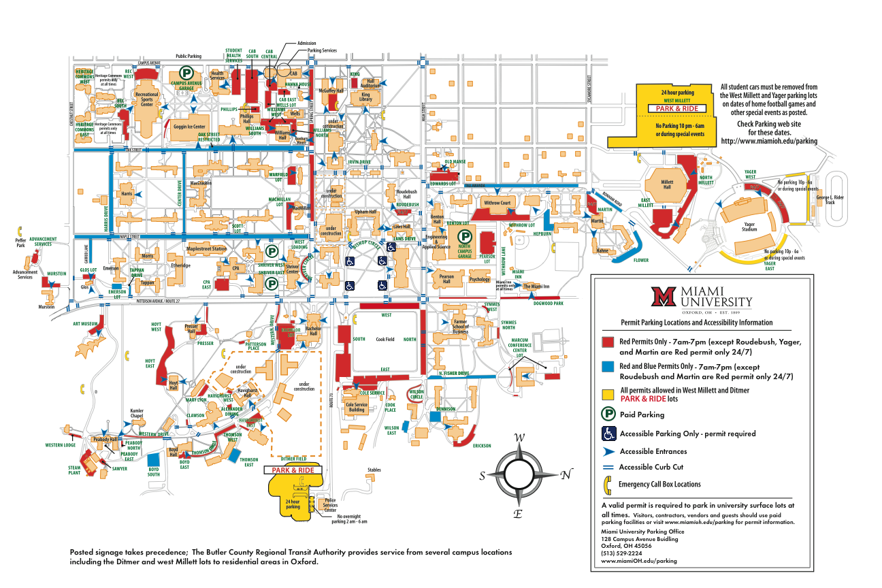
Notes:
The yellow sections are the only parking pass options available to upperclassmen, no where near where there jobs may be.
The blue areas show parking pass options for students living on campus. They are more available, but it would seem students living on campus would have less need to be close to their workplace, and are more likely to be able to walk.

Slide 8
Parking meters
Parking meter time limits are enforced. Parking meter time limits at most meters are:
Monday-Friday 7am-5pm: 45 minutes
Monday-Friday 5pm-10pm: 2 hours
Saturday-Sunday 7am-10pm: 2 hours

Slide 9
solution
Free Student Employee Parking Passes
Able to scan at meter zones
Passes would only be honored at closest parking region to your employer to prevent misuse

Slide 10
benefits
Students will not have to pay out of pocket
Goodwill from students
Shows appreciation for employees
No additional cost to the university

Slide 11
summary
Problem with on-campus parking for student employees
Solution would offer free parking to student employees by using specialized passes for meters and lots
Benefits both students and Miami

