Slide 1
I write these words, but do I own them?
Rethinking authorship in online spaces
A lit review by:
Dustin Edwards (et. al)*

Slide 2
Collaborative writing:
2 schools of thought
Camp 1
Collaborative writing occurs when two or more people produce a written text.
Camp 2
All writing is collaborative.
Notes:
Obviously this is oversimplified. Camp 1: Discuss Ede and Lunsford. Camp 2: discuss poststructural theorists. Becomes troubling to discuss collaboration when such stark differences in definition exist.

Slide 3
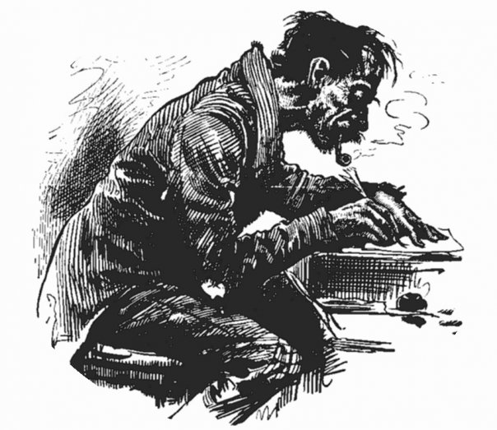
The lone creative genius is a myth.

Slide 4
Write
Can we have an original moment?

Slide 5
Capitalistic and Romantic notions say:
Yes, of course.
Notes:
In traditional terms, Selzer suggests texts are understood as self-contained artifacts. One person, the author, is the creative genius.

Slide 6
Many poststructual theorists, however, complicate textual ownership.
“Any text is constructed as a mosaic of quotations; any text is the absorption and
transformation of another.”
--Kristeva, 1980
“…A text is made of multiple writings, drawn from many cultures and entering into mutual relations of dialogue, parody, contestation, but there is one place where this multiplicity is focused and that
place is the reader, not, as was
hitherto said, the author.”
--Barthes, 1968

Slide 7
Let’s consider Kristeva’s term,
intertextuality.
Discourse is an interaction among writers,
readers, and other texts (Selzer, 1993).
“All texts are interdependent: We understand
a text only insofar as we understand its precursors” (Porter, 1986).
Meaning ultimately is drawn from
the reader (Barthes, 1968).
Notes:
Define intertextuality

Slide 8
“Life, Liberty and the pursuit of Happiness”
Social cliché of the time
By deconstructing the Declaration of Independence, Porter shows
the theory of intertextuality.
“…All men are created equal”
Sentiment found in a childhood commonplace book

Slide 9
Still…
Even Barthes who said the author is dead still has his name attributed to his essay. Clearly, authorship matters. But why? To what extent? Are notions of authorship changing?

Slide 10
Epistemological tensions
“What could it mean—to have this power of language, history, and culture? to own it?
Bartholomae
1995
“Writers usually want some ‘ownership’, some say, some control over what a text means”
Elbow
1995

Slide 11
Another complication: technology
A wiki ( /ˈwɪki/ WIK-ee) is a website that allows the creation and editing of any number of interlinked web pages via a web browser using a simplified markup language or a WYSIWYG text editor.^{[1][2][3]} Wikis are typically powered by wiki software and are often used to create collaborative works.

Slide 12
Some (possible) answers

