Slide 1
A Proposal to Re-assess the Grading Criteria in Undergraduate Psychology Classes
Rachel Hoffman
Notes:
INTRODUCTION: Hello, my name is Rachel Hoffman, and I am an undergraduate student here at Miami University, majoring in psychology with a minor in rhetoric writing. Being a third year psychology major, I have taken approximately ten psychology courses over my three years here. These courses having ranged from introduction to psychology to statistical methods, while also participating as an undergraduate research assistant for Dr. Amity Notlemeyer and as an introduction to psychology break-out group instructor under the direction of Dr. Peter Wessels and Dr. Leonard Mark. Having taken a vast array of the psychology courses offered here at Miami University, while also working with the chair of the psychology department, Dr. Leonard Mark, I have had the opportunity to work with many professors within the psychology department, as well as experience a variety of grading criteria for each class I have taken. Being a psychology major, I am interested in the material I learn in each course I take through the psychology department, and genuinely want to learn and engage in each new set of knowledge and material I gain from each class… but I am discouraged to engage in true learning due to the harsh grading criteria some of the professors utilize within the psychology department. By re-assessing the grading criteria in all undergraduate psychology classes, and holding each psychology class to a universal grading criteria throughout the department, undergraduate students, like myself will engage in more useful learning and gain long-term knowledge through these classes no matter what their learning style.

Slide 2
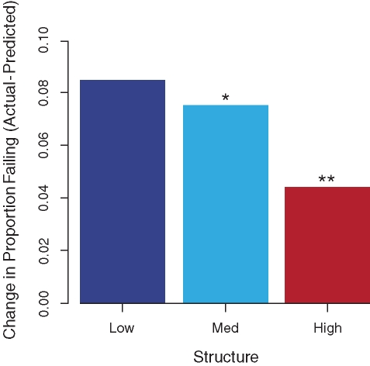
What is the issue at hand?
Study: Freeman, Haak, and Wenderoth: “Increased Course Structure Improves Performance in Introductory Biology”
Data: Failure rates controlled for predicted grade as a function of course structure- low-, medium-, and high-structure courses- the difference between the proportion of students predicted to fail and the actual proportion of failing decreases with increasing structure
Notes:
PROBLEM: So what is the issue with the grading criteria in undergraduate psychology classes? Students who take a psychology class to fulfill a Miami Plan or College of Arts and Science credit, as well as psychology majors, are subjected to taking certain psychology classes that only utilize exam scores to reflect their overall grade in the class. Being a student who is invested in learning about psychology but a poor test taker, some of my classes in the psychology department do not fully reflect the effort and time I put into each class due to the outcome of a poor exam score which leads to an overall poor course grade. Psychology classes that only use three to four exam scores to determine the student’s overall grade in the course discourages students from engaging and finding interest in the material, where instead they’re cramming and stressing about the material, as well as not fairly reflecting the time and work, the student has put into the course as well as the overall mastery of the material necessarily.
SUPPORT: Past studies have supported this idea of not subjecting students’ overall course grade to only exam scores, such as in the study by Freeman, Haak, and Wenderoth’s on “Increased Course Structure Improves Performance in Introductory Biology”. This study supports this notion that students’ efforts in a course are better represented and reflected in their overall course grade when given more assignments in a grading criteria rather than just basing their grades purely off exam scores- in this study, the authors discovered that “highly structured course designs, which implement reading quizzes and/or extensive in-class active-learning activities and weekly practice exams, can lower failure rates in an introductory biology course for majors, compared with low-structure course deigns that are based on lecturing and a few high-risk assignments” such as exam scores. “ Active-learning exercises can make students more skilled learners and help bridge the gap between poorly prepared students and their better-prepared peers”.
As this graph shows, higher-structure courses have better course grades overall and dropped in predicted expectations of how many students would fail the introductory course in biology at Washington University versus students who actually failed the course. In this study, higher-structure courses used Socratic lecturing (questions posed to the class- used to engage their attention and provide feedback to the instructor), ungraded active- learning exercises (such as answering questions to case studies in informal groups), clicker questions (summing to 12% of the overall course grade), practice exams (8% of total course grade), class note summaries (2%), reading quizzes (8%), in-class group exercises
Their overall grade was determined by 50% exam scores and 50% total course points.
http://www.ncbi.nlm.nih.gov/pmc/articles/PMC3105924/

Slide 3
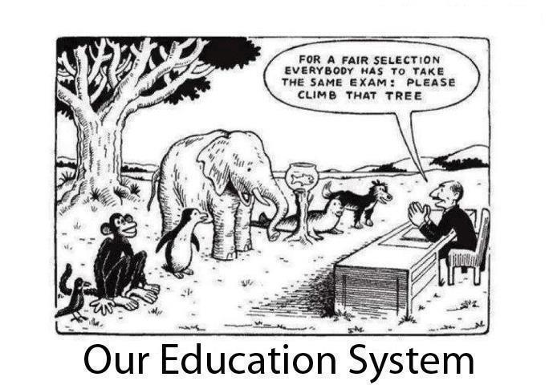
Notes:
FINDINGS: So according to this study, students learn better in a classroom that utilizes many different types of learning methods, from in class writing to clicker questions, and it reflects on their overall course grade more positively.
Why could some students who did not understand the material as thoroughly, and did not put as much time and effort into the class end up receiving a higher grade in the class overall? This may be due to the overall intelligence of the student, as well as the skill of being a good “test taker”.
Exams are only one measurement of one way of learning that does not play to all students strengths. So if a student isn’t a good test taker, or has test anxiety, how can we measure their mastery of the material to cater to all learning styles?

Slide 4
Solution: Cater to all learning styles
Undergraduate Psychology classes can create a student’s overall grade based on:
In-class writing assignments
Out-of class/essay writing assignments
Extra credit homework packets
Clicker questions
Practice exams
Reading quizzes
Exam scores
Notes:
SOLUTION: Instead of just using three to four exams to determine the overall mastery of the material of a particular psychology course, professors can also assign short writing assignments in class to reflect on the material presented, assign essays to further analyze the depth of the material, extra credit homework packets before an exam can be assigned to help students study and to show the professors which students takes the time to learn the material, and review the material outside of class. A clicker can be used within the classroom to gage active participation, by flashing questions on an overhead and giving students points for simply participating in class.
By using these many different forms of assessment, if a student is a poor exam taker, they can make up the points in other areas that reflects on effort, hard work, and understanding of the material presented in class- a fairer system than what is currently being implemented in some psychology courses.

Slide 5
So what now?
Create an overall grading criteria for all undergraduate psychology courses at Miami that cater to all learning styles
Will require professors to update syllabuses and add new material to their courses
Notes:
SOLUTION: So what now? Undergraduate psychology courses at Miami University need to adhere to an overall grading criteria that uses other ways to assess student’s effort, time put forth, and mastery of the material other than just exam scores.
By using these other forms of assessment, the psychology department will not be discriminating against learning styles, and helping all students who are interested in psychology, like myself, receive a positive and more nurturing learning environment that students can take important information away from.
Thank you.

