Slide 1
Prisons, plagues, & Momma jokes:
The Rhetoric of Online Plagiarism Tutorials
Dustin Edwards
New Mexico State University

Slide 2
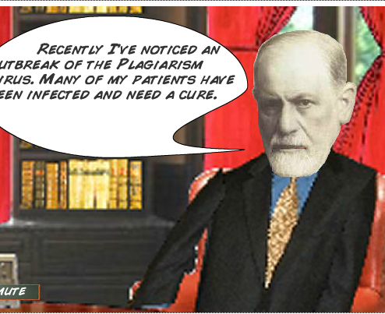
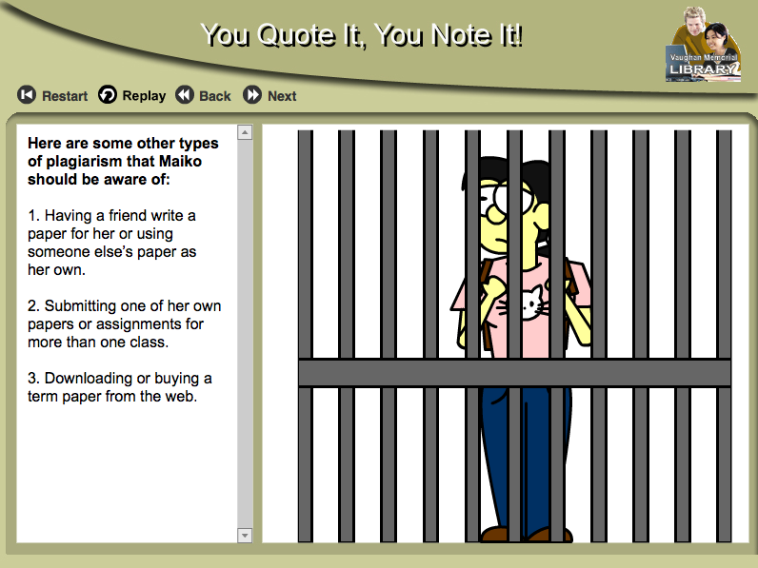

Slide 3
How did I get here?
Student query – “How do I know if I’m plagiarizing?”
Artifacts – 3 multimodal plagiarism avoidance tutorials
Disconnect between plagiarism literature and the messages of the tutorials

Slide 4
“You Quote It, You Note It”
University-sanctioned resource for students
Hosted by Acadia University

Slide 5
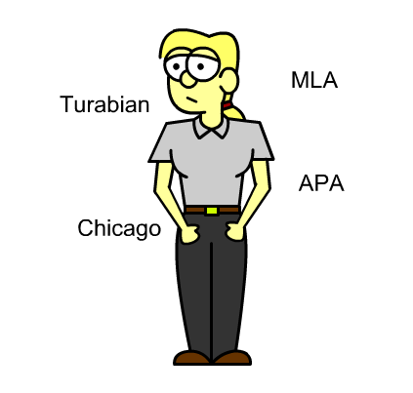
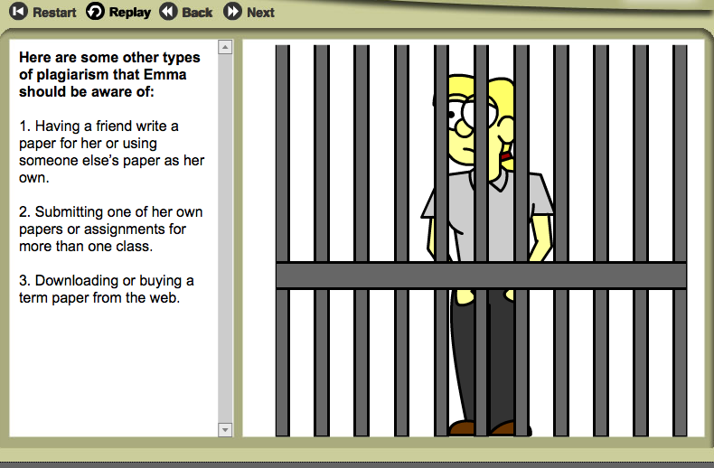
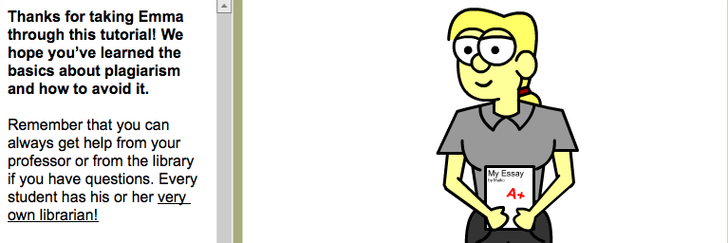
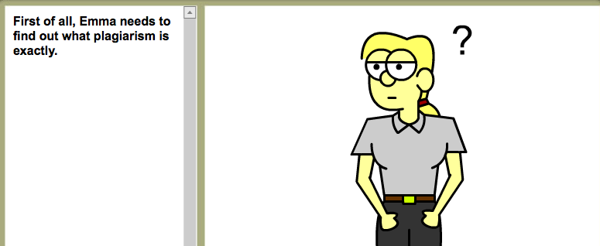
Navigation

Slide 6
Dr. Cite Right
Accessed from FY writing research guide (NMSU library website)
Hosted by Central Piedmont Community College

Slide 7
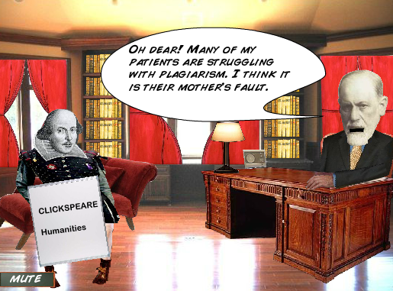
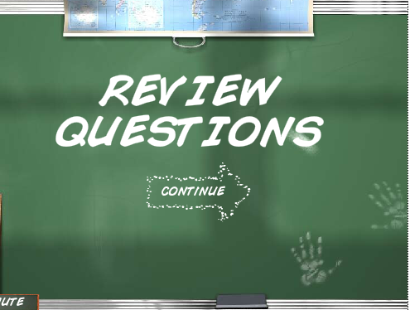
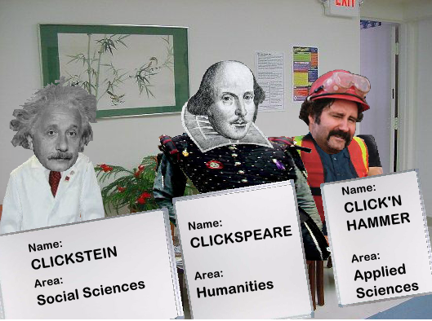
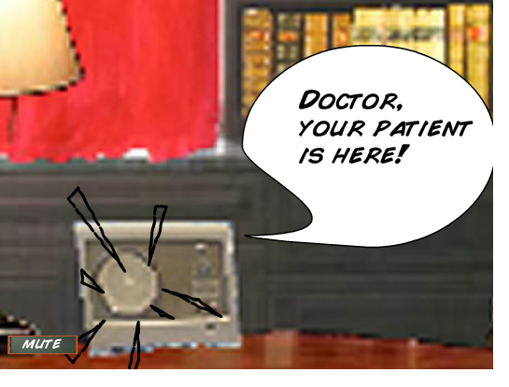
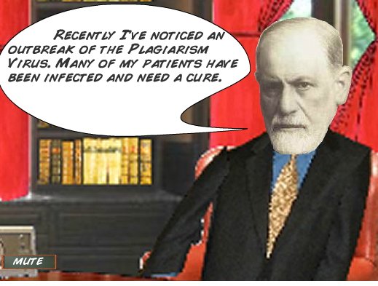
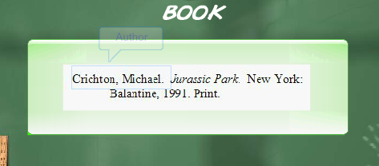
Navigation

Slide 8
The Plagiarism Court
Accessed from FY writing research guide (NMSU library website)
Hosted at Fairfield University

Slide 9
Navigation

Slide 10
Why are the tutorials problematic?
Positioning of students
Damning, incarcerating visuals and metaphors
Monolithic definitions and disregard of non-dominant literacy practices
Disconnect with authorship practices outside of the academy

Slide 11
Negative student positioning
Valentine (2006) points out, plagiarism, and therefore its avoidance, is a literacy practice that involves much more than the memorization of formal citation rules
It follows, then, that in order to acquire valued
academic authorship practices (“ways of using language” and “of thinking”), students must be immersed in a specific discourse in a way that is “socially meaningful” (Gee, 1989).
Gee (1989) describes how complex mastering a literacy (discourse) can be:
“socially accepted association among ways of using language, of thinking, and of acting that can be used to identify oneself as a member of a socially meaningful
group” (1989, p. 18).
The tutorials, however, present students as ignorant and passive.
They are placed, from the start, in a position of distrust.

Slide 12
Problematic visuals
Rebecca Moore Howard regards plagiarism, and the words we use to code it, as being part of a discourse that uses metaphors of “gender, weakness, collaboration, disease, adultery, rape, and property” (p. 474).

Slide 13
Monolithic definitions
For each tutorial, all writing situations receive the same definition and consequences of plagiarism
By situating plagiarism among other forms of authorship…students
[are provoked] to think about how plagiarism functions in a culture
that is obsessed with authenticity and originality” (p. 37-38)

Slide 14
Disregard of literature
Situates plagiarism as a form of authorship (Robillard, 2008)

