Slide 1
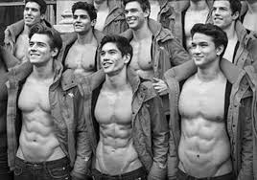
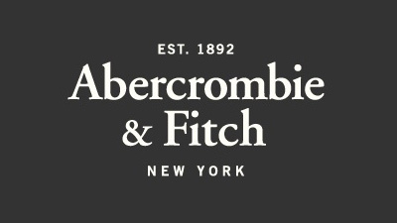

Slide 2
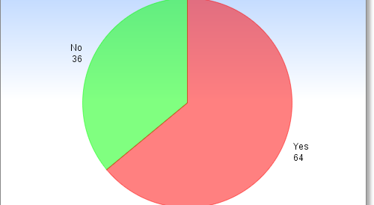
Does Abercrombie advertising affect your choice to buy the brand?

Slide 3
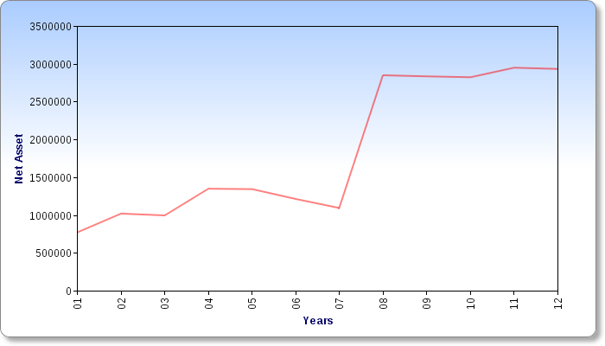
No catalog vs. catalog

Slide 4
Interviews
As I interviewed past and present Abercrombie employees, I asked them to describe the Abercrombie image portrayed through their advertising.

Slide 5
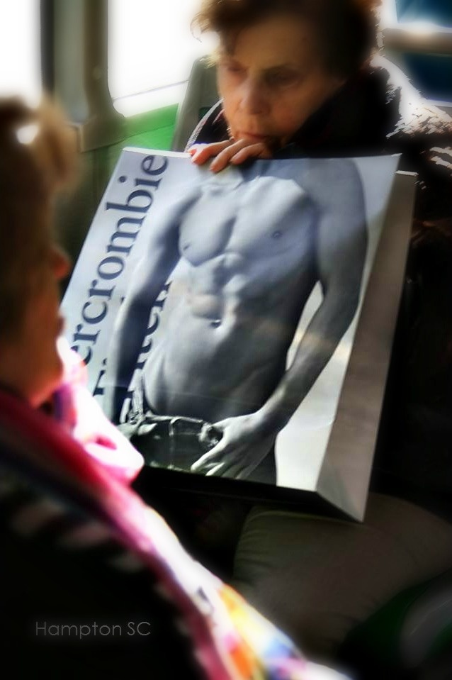
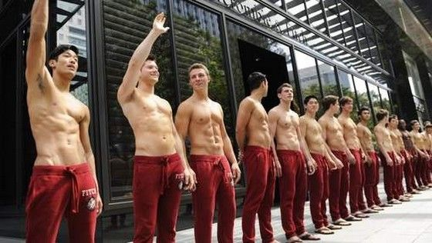
“The dirtier, the better.” – Justin
“The less clothing, the better our sales.” – Kierra
“Our brand image is not a good representation of our products.” – Mallory

Slide 6
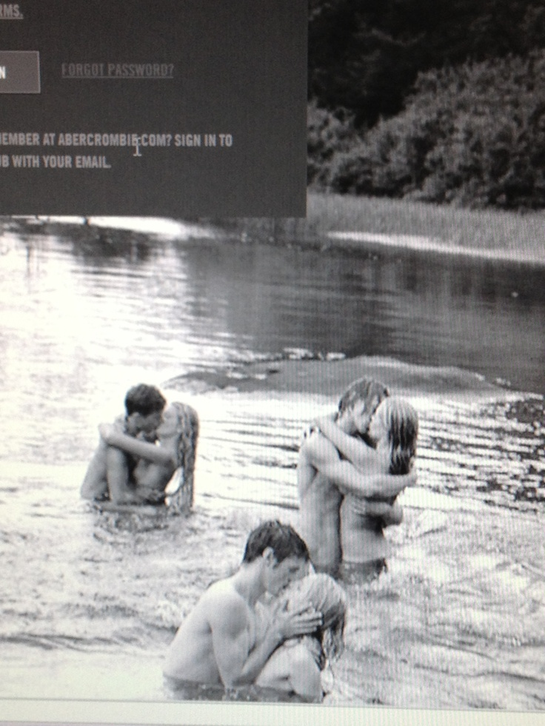
“Less is more” – Sam
“Look like everyone else, with a focus on sex.” – Alex
“Clearly we have our priorities; focusing on the way it is presented rather than the products we actually sell.” -- Mike

Slide 7
Proposal:
I want Abercrombie to change their advertising to be less explicit. There are many different advantages this would have to both the brand images itself and the company sales. I propose that Abercrombie switches their focus from being sexy and not including the products, to focusing on the unique products sold and their “all-American” environment.

Slide 8
Sources
www.google.com (images)
Investors. (n.d.). Retrieved from http://www.abercrombie.com/anf/investors/investorrelations.html
Abercrombie plans another porn catalog. (2003, December 05). Retrieved from http://www.abercrombie.com/anf/investors/investorrelations.html
www.chartgo.com

