Slide 1
Getting Back on Track

Slide 2
Investigating
Finding the expenditures from physical operation, and profit/loss reports.
Pre-Outline
Writing the owner a outlined draft of problems found and solutions to decrease expenses
Creating the Proposal
Creation of a proposed solution for the owner to implement
Getting Approval
Presenting the proposal for approval to implement solutions

Slide 3
Investigating the Problems
The restaurant expenditures discovered in these areas are excessive within the normal limits. These expenditures explain a substantial profit loss.
Food ordered returned & compensated
Food prep waste
Over cook waste
Carryout food condiments inventory waste
Loitering on time clock, resulting in payroll losses
Employee over staffing in low volume hours

Slide 4
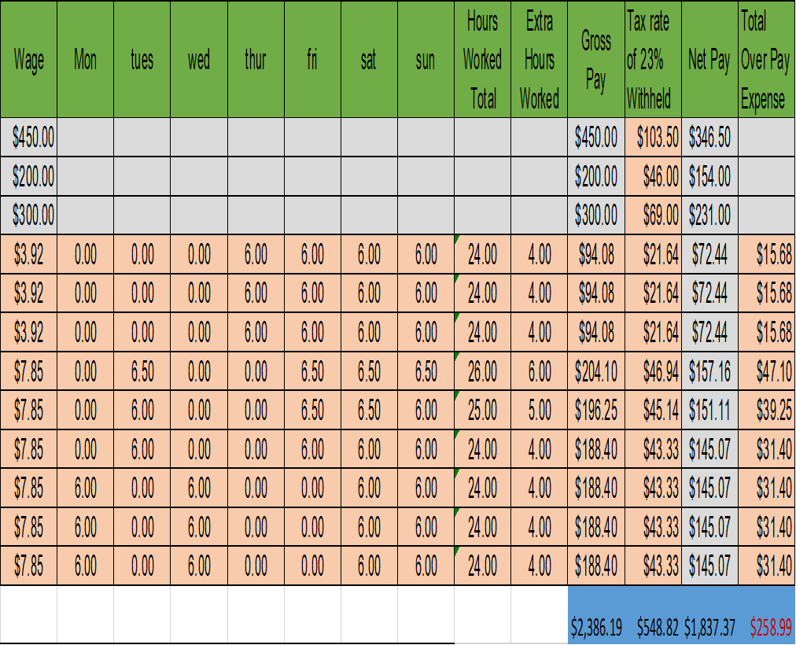
Payroll Problem

Slide 5
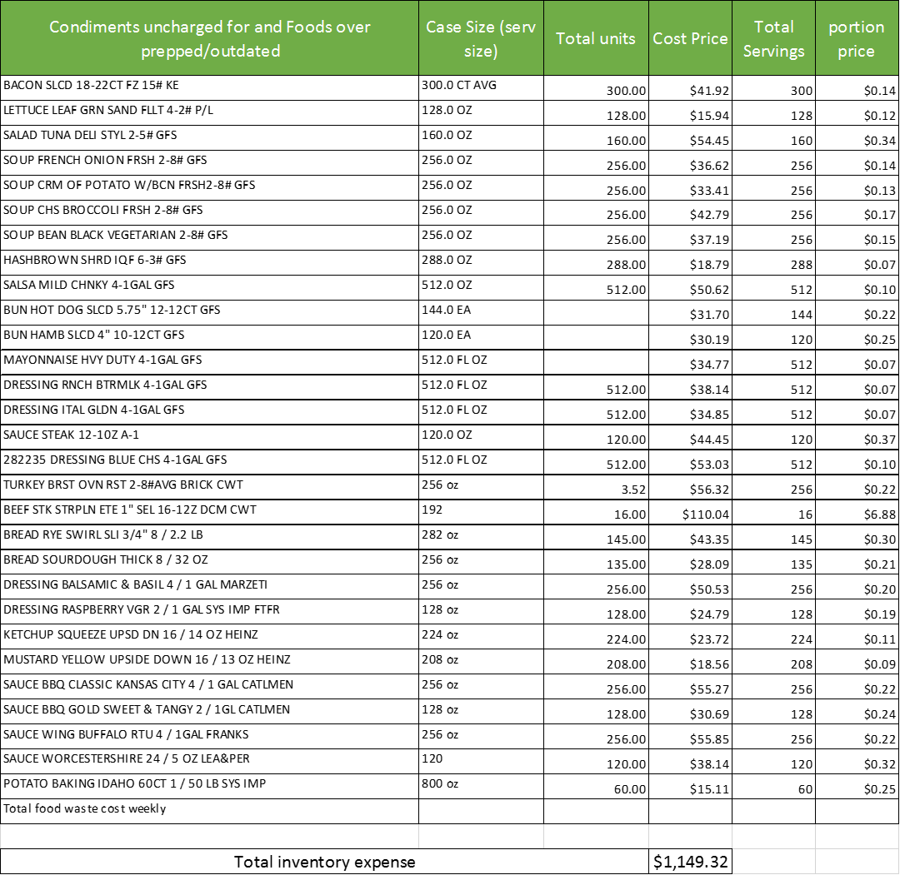
Inventory Problems

Slide 6
Last Years Sales

Slide 7
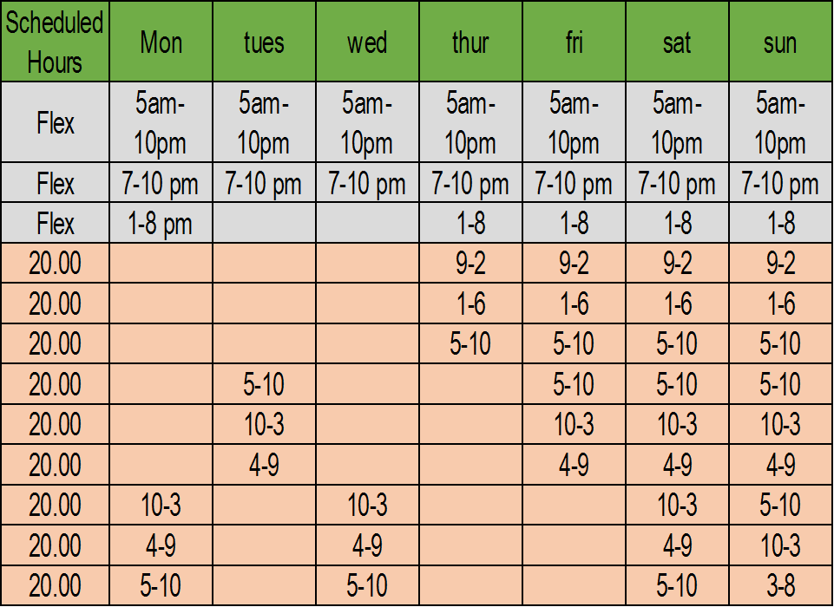
The New Schedule

Slide 8
What Problems was Found
Comfortable working environment and being lenient with employees
Management/staff not following procedures and guidelines
The cooks not paying attention to tickets and food as its cooking
Over prepping or over cooking instead of following rules.
Attention to carryout inventory guidelines not followed
Employee excuses for not doing assigned work and/or leaving for another employee
Loitering on time clock

Slide 9
Goals and Objectives
This project demands significant involvement by the owner and staff. Success is highly dependent on their effort. A successful implementation of the proposal by proceeding with the following:
Follow the solutions listed under Recommendations
Owner & managers enforcing rules, policies, and guidelines
Managers as well as the staff held accountable to follow these polices and guidelines in the effort of reducing the expenditures

Slide 10
Proposal Recommendation
Reposting of rules and procedures at all, stations by replacing all old signs so there can be no argument over them.
Implementing verbal then written disciplinary for staff not following proper procedures and rules of operations posted.
Disciplinary for not doing assigned job duties as applies to positions assigned for the shift.
After a certain number of write-ups employee terminated as insubordinate to procedures.
Dates and times on containers when food prepped or put away at closing.
Properly counted servings of all carryout condiments for orders.
Order tickets on the kitchen lines read and set up as they come in.
Food orders expedited (checked and setup) by manager or by lead wait staff before taken to table to ensure accuracy and meals are properly prepared.
Employees clocking in or out at assigned times unless managers approval obtained and signs the docket sheet for the owners records.
Medical excuses now required for all call offs without a minimum 6 hours prior to employee’s scheduled shift.
Employee must find another employee to cover for that shift prior to the scheduled time if employee must call off.
If the emergency is not medical, the employee must provide a validated reason or employee written up.
Extra employees not scheduled when the business is low volume.
Employees released if coverage not needed and business is slow for any reason.
Write up a new schedule that only overlaps during heavy hours coverage.

Slide 11
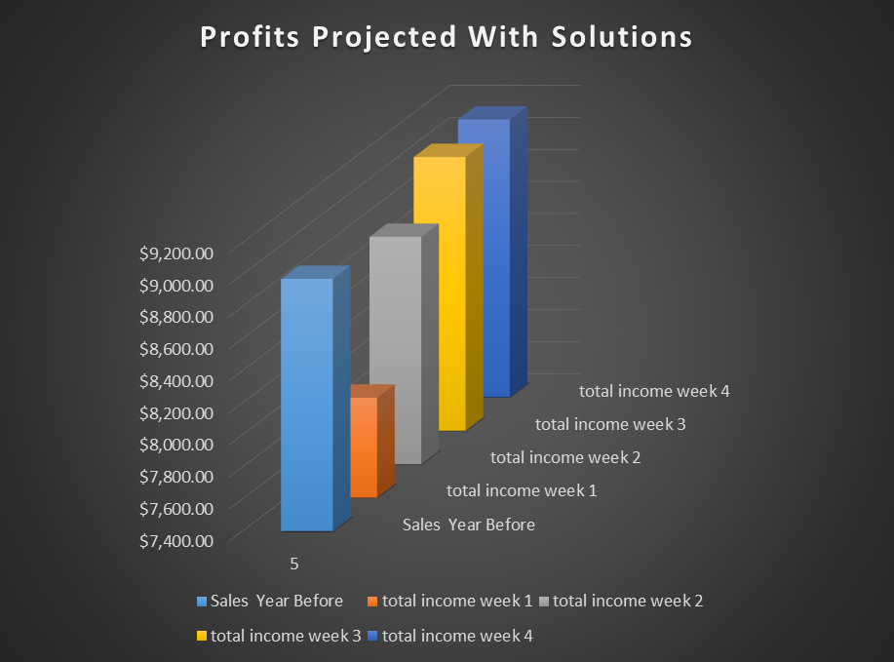

Slide 12
Benefits
When solutions is implemented, the business will see the decrease in wasted foods and payroll problems based on operational profit/loss report. This will be charted by comparisons from week one of implementation to week six. The decrease of expenses charted in each of the six weekly sales & payroll reports. Comparison of inventory reports against wasted lists and the Returns & Compensated Meals list against sales charted. These comparisons against the list of over prepped and outdated waste expenditure reports as the proposed actions are carried out. This proposal will not cost the business more than the cost of office materials, as the office printer for the business has the capability to print the signs, and a laminator for protecting the signs. Replacing existing as well as new policy or guideline signs.

Slide 13
Business is Business
The Souper Kitchen needs to focus on the following:
The payroll and docket sheet
Inventory changes outside of normal ordering
Staff adhering to rules and guidelines
Keep from being casually friendly with managers or staff
Leniency can be taken advantage of, which the realization of a situation being abused, while business ends up being effected. This should be a suggestion to business owners to limit association with employees.

