Slide 1
Creating digital presence
Writing for Linkedin and Social media

Slide 2
overview
Understand why digital presence is important for employment in today’s global, digital economy
Demonstrate useful web applications for creating presence on the job market
LinkedIn, About.Me, professional blogging and websites, Twitter, and other social media
Overview the dos and don’ts of promoting yourself online

Slide 3
Why think about digital presence?
A resume builder that lets your potential employers know more about you
Opportunity to show what you do
Potential to stand out in the crowd
A way to network and connect with other professionals

Slide 4
Linked in—by the numbers
238 million+ registered members
84 million in the U.S.
2 new members join every second
30 million+ users are students or recent grads

Slide 5
Tips for Linkedin
Use a professional, updated photo
Make the most out of your headline
Write an informative yet concise summary
Follow businesses that are relevant to your interests
Be active

Slide 6
Your photo—your readers’ 1st clue of your professional identity
What you should have
Bright, well-lit image
An approachable look
A professional look
What to avoid
Self portraits/“selfies”
Grainy, pixilated images
Group photos

Slide 7
Make the most of your headline—120 characters to market yourself
Don’t go with the default
Profile --- > edit profile --- > edit headline
Let your headline capture the “so what” of your professional identity
Showcase your specialty
Speak directly to your target audience
Be specific
Include key words
Be creative
Source: Forbes, “How to Make Your LinkedIn Headline Stand Out”

Slide 8
Effective headlines

Slide 9
Write your headline
Showcase your specialty
Speak directly to your target audience
Be specific
Include key words
Be creative

Slide 10
Writing Linkedin summaries
Model the style of other professionals in your industry
Use first person
Integrate key words
Avoid big chunks of text
Avoid clichés or overly used selling words

Slide 11
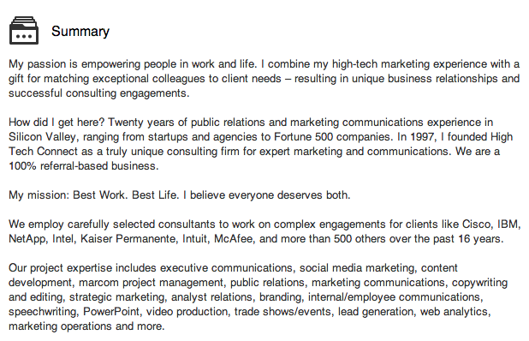
Example summary

Slide 12
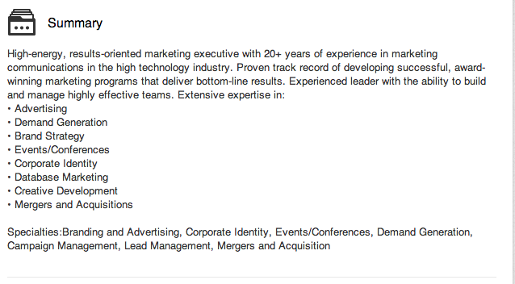
Example summary 2

Slide 13
Generate a list of 10 keywords
What are your specialties?
How might you attract employers looking for niche specialties?
How will you incorporate these into your summary and headline?

Slide 14
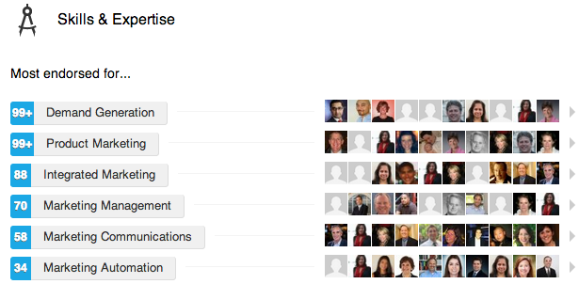
Be Active—endorse, connect, & follow
If you endorse on LinkedIn, you’ll likely get endorsements back
Send personalized messages to those you want to connect with; avoid the stock message
Follow businesses, organizations, and people

Slide 15
Join a group—in fact, join lots of groups!
Job Listing Groups
Job Openings, Job Leads and Job Connections!
Job-Hunt Help
Professional Organization Groups
Harvard Business Review
Business Professionals of America
Note: Groups are automatically set to show on your profile. If you don’t want them to show, change your settings.

Slide 16
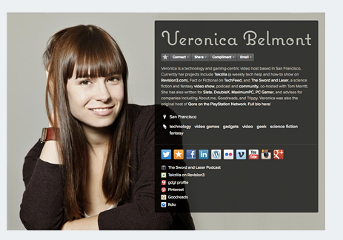
About.me
Is a (free) online business card
Connects your digital presence in one central location on the web

Slide 17
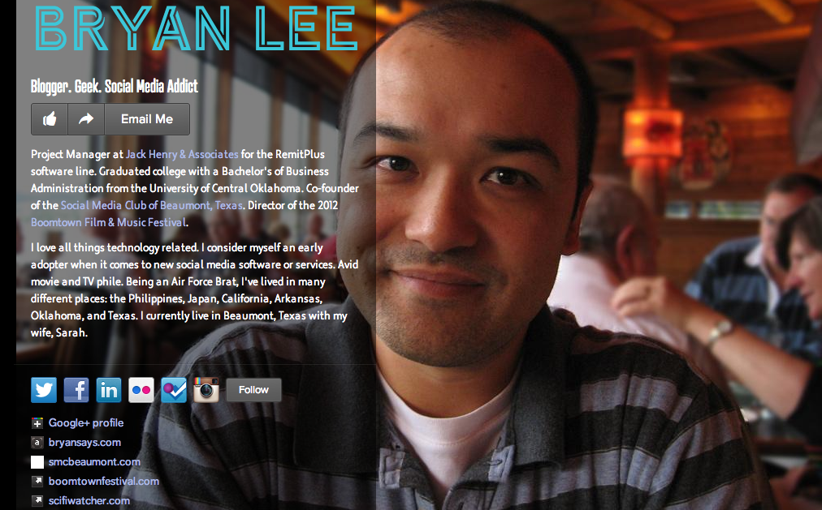

Slide 19
Twitter
Use an informative, catchy bio
Link out to your professional website, LinkedIn, or About.Me page
Follow industry leaders
Use it as a space to display what you’re reading/find interesting
Be active—retweet, favorite, and reply to others’ tweets

Slide 20
Make a list of what social media you may want employers to find
Think about ways in can link your social media together
Determine what social media applications you should invest the most time in
Contemplate how—if at all—you want to blend your personal likes/interests with your professional social media presence

Slide 21
blogging
Think of blogging as your resume in action—a space in which you think about, write about, ask questions of, and post content on your professional interests and activities
A space for you to stay current, sharp
A space for you to welcome interactivity
A space for you to link to ideas you find attractive
A space for you to build a voice
A space to point future employers to

Slide 22
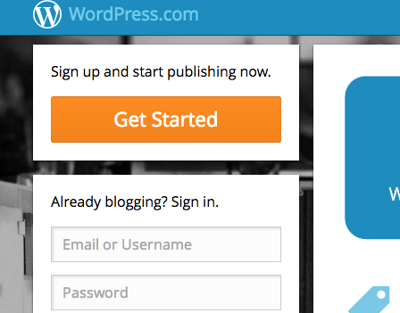
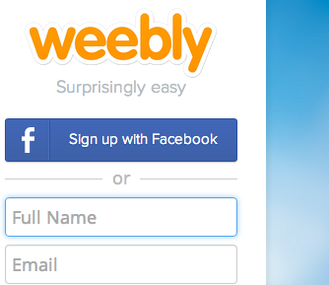
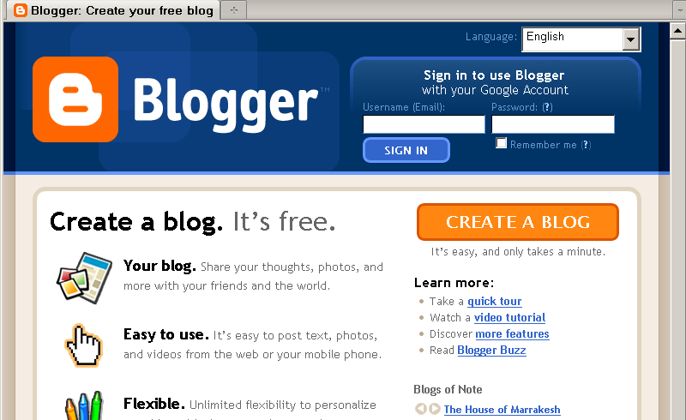
Wordpress, blogger, weebly

Slide 23
More than Blogging— Building a professional portfolio
Include personalized, (fairly) detailed “About Me” page
Integrate other “hallmarks” that display what you have done

Slide 24
Some parting advice
Develop a professional identity plan. Write it. Map it. Carry it out.
What do you want to highlight? How do you want to display your interests, accomplishments, and digital activity?
Model what’s done in your industry. Although it might seem advantageous to be a trend setter, you’ll want to have the basics down first.
Take a look at lots of examples—from longtime industry leaders to new hires—to determine how, if it all, professionals in your industry are using social media
Begin to build a voice.
Think of yourself as contributing to an ongoing conversation. What can you add to it? How can you set yourself apart from the rest? What social media tools can help you accomplish your goals?

